Slide 1


Healthcare Dataset: Project_1
Presenters:
Preslav Petrov
Antonios Bourlis
Notes:
Το περιεχόμενο που δημιουργείται από ΑΙ μπορεί να μην είναι σωστό. ---

Slide 2

Healthcare Dataset: Exploration & Validation
An analysis of a 55,392 patient dataset, examining :
Gender separation
Distribution of staying length
Distribution of billing amount
Distribution by Age Category
Billing Amount by Medical Condition
Medical conditions
Blood types
Data integrity

Slide 3

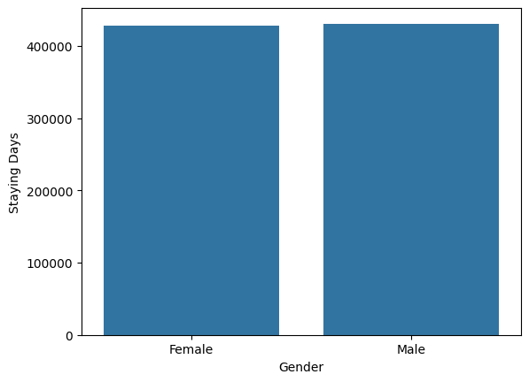

separation into men and women

Slide 4
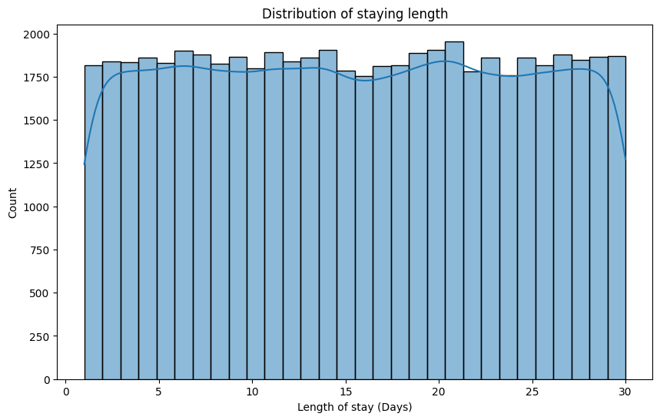
Distribution of staying length
According to the graph the data are distributed uniformly.
Maximum length of stay is 30 days.
Minimum length of stay is 1 day (the patient had a simple service).

Slide 5
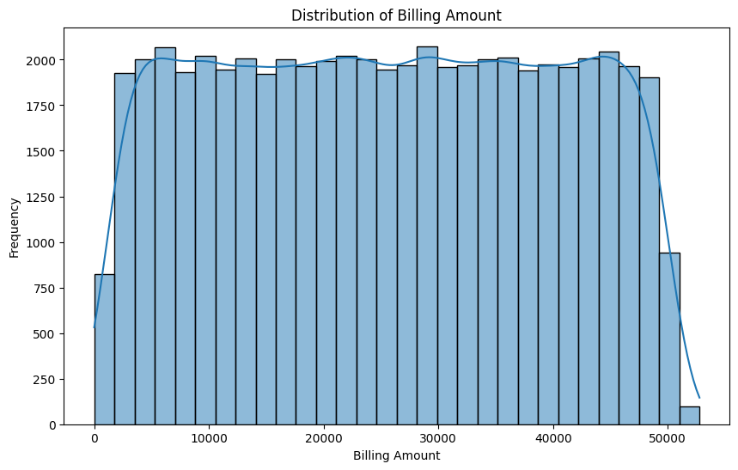
Distribution of billing amount
Max billing amount 52.765 dollar.
Minimum billing amount 9.20 dollars (< 1 days staying).

Slide 6
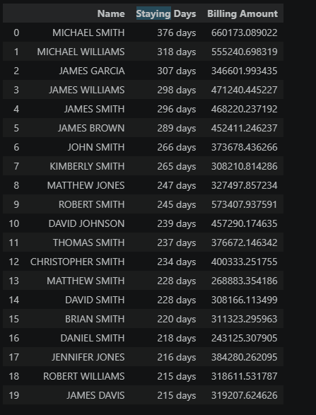
Top 20 customers by length of stay

Slide 7
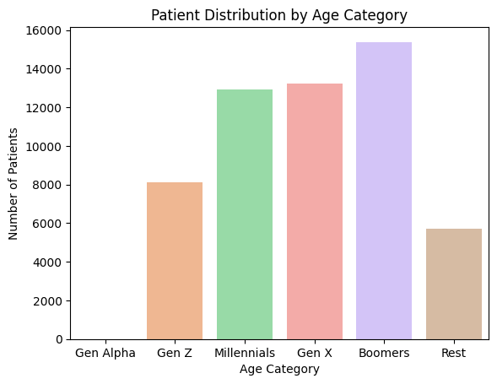
PATIENT DISTRIBUTION BY AGE CATEGORY
Boomers and Gen X have the first class of patients
Gen Alpha no contact with hospitals

Slide 8
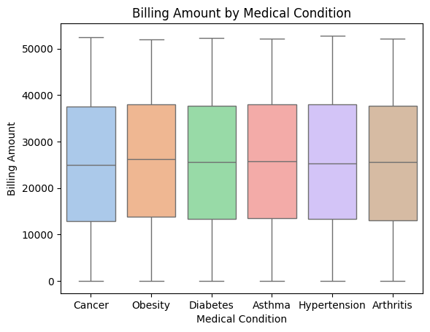
PATIENT DISTRIBUTION BY AGE CATEGORY
All medical conditions have slight differences in payments.

Slide 9
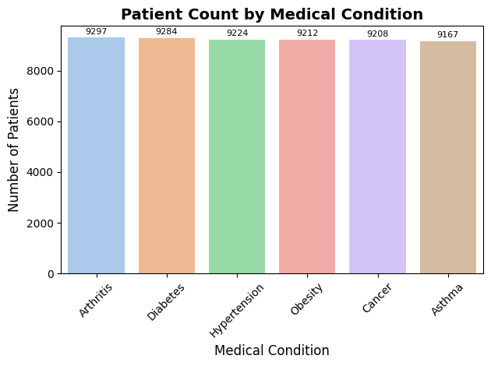
MOST COMMON MEDICAL CONDITIONS
Arthritis is technically the most common (9.297 cases).
However, the distribution across all six conditions is remarkably even, with each accounting for roughly 16% of the dataset.

Slide 10
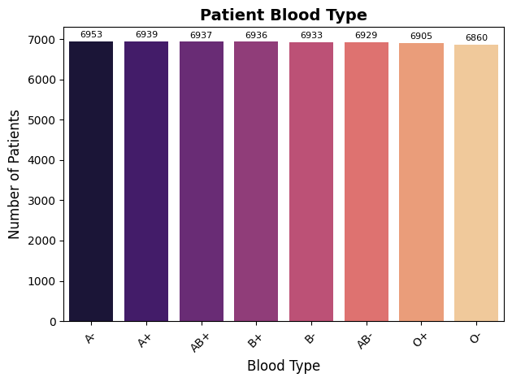
MOST COMMON BLOOD TYPES
Blood type A- is the most frequent.
Like medical conditions, every blood type (including rare ones like AB-) constitutes approximately 12.5% of the patient population.

Slide 11
DATA INTEGRITY-CONCLUSION
This is a synthetic dataset: Generated using uniform distributions (likely via Python's Faker library), this data was created for practice, not real-world insights.
Excellent for coding practice: It remains highly valuable for practicing data manipulation, cleaning, EDA, and visualization techniques using Pandas and Matplotlib.

